Slide 1







Web Programming Lab Session : HTML
FSTM KUIS

Slide 2

Web Programming PHP with
FSTM KUIS

Slide 3


+ bootstrap 5 + vanilla Javascript + own icon library + navbar optimised
5
khirulnizam.com

Slide 4
Download XAMPP apachefriends.org
FSTM KUIS

Slide 5




3-tier
Tier3 : Database
Tier1 : Client/browser
Tier2 : Middleware (Webserver + PHP)

Slide 6


T1: CLIENT (BROWSER HTML)
The User-interface

Slide 7
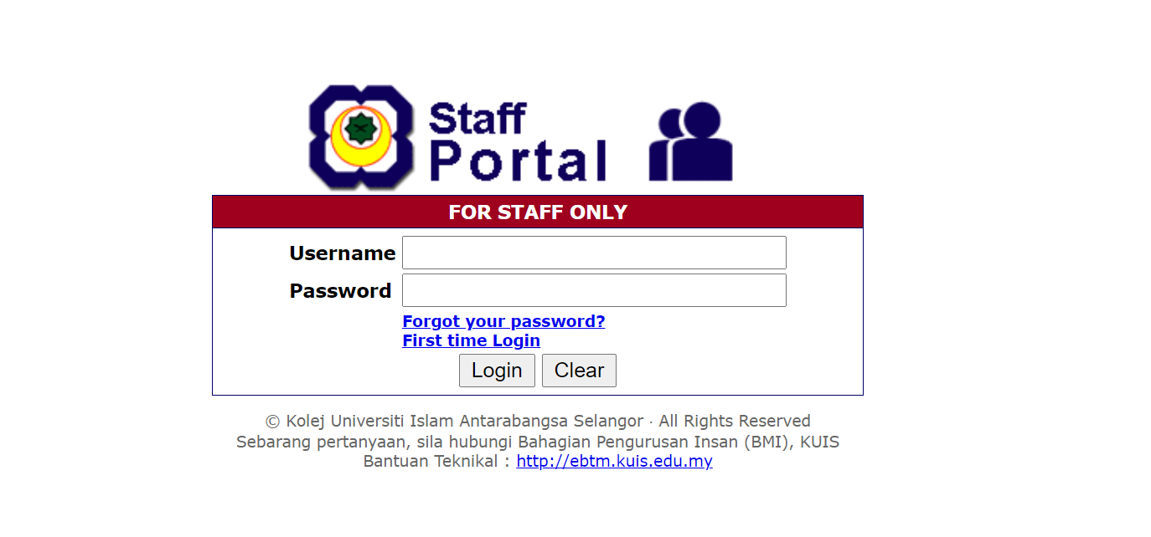
Web APPLICATION PROCESS

Slide 8

T2: Web server + PHP interpreter
Hold logic/ business process
Server-side scripting
Dynamic web

Slide 9

T3: DATABASE
Place to hold database/records/data

Slide 10

LARAGON.ORG
Development stack
https://laragon.org/download.html
Apache/ Nginx / PHP/ MySQL / NodeJS / etc…

Slide 11
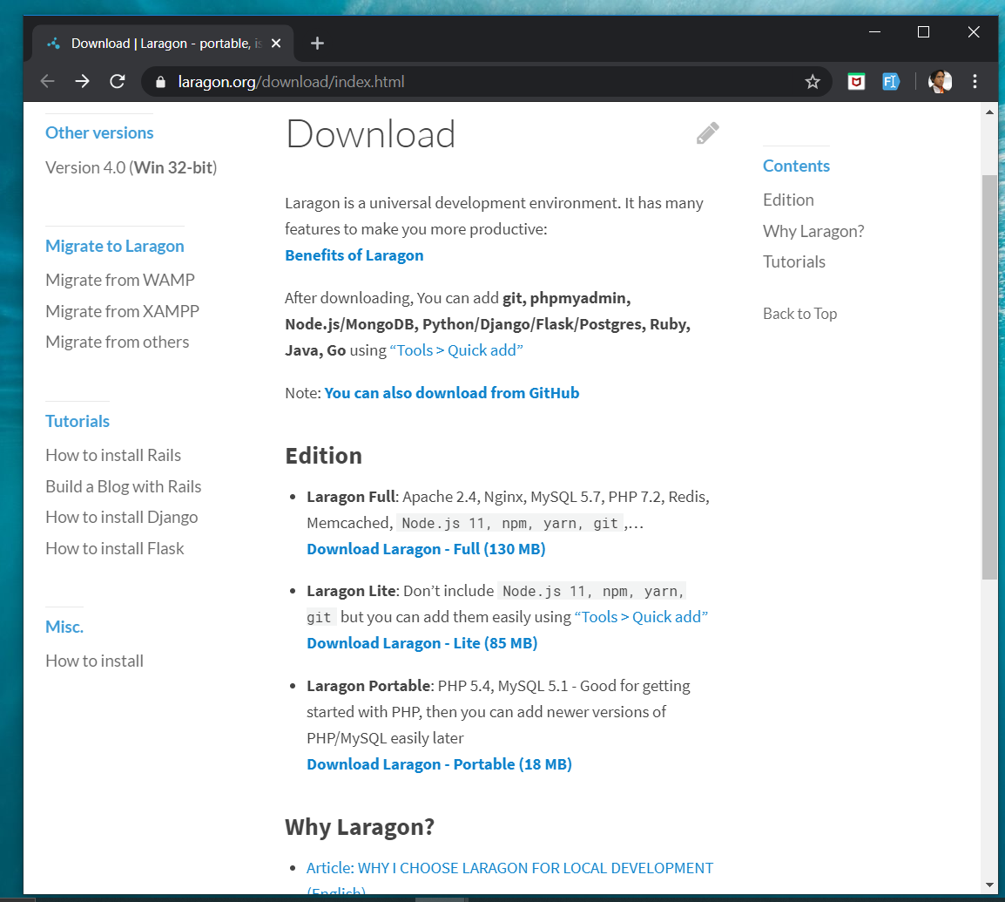
DOWNLOAD
Laragon.org/download

Slide 12
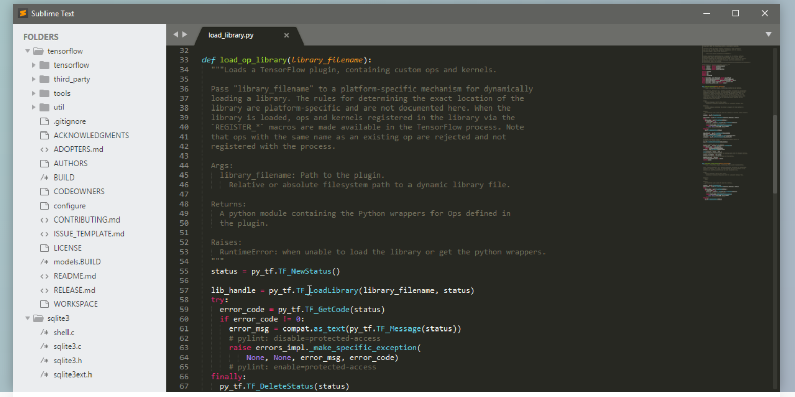
www.sublimetext.com

Slide 13
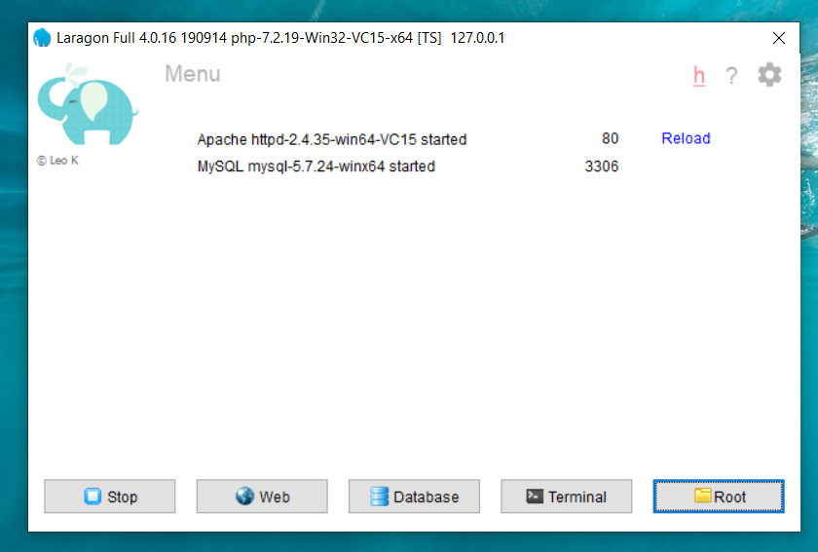
LARAGON INTERFACE
Start/stop servers
localhost
db client (HeidiSQL)
cli/npm/composer
go to webroot folder

Slide 14
T01 HTML5 & Bootstrap (Web Programming)
FSTM KUIS

Slide 15

T01 HTML5
w
bit.ly/fstmtube

Slide 16
Training outline
HTML5 – refers to the modern day of HTML which promotes native handling of video & audio & animation without having to install additional plugins to browser.
Bootstrap – A HTML framework supports responsive web design to provide one time webpage development for smartphone, tablet and desktop.

Slide 17
HTML5
HTML5 – refers to the modern day of HTML which promotes native handling of video & audio & animation without having to install additional plugins to browser.
<!DOCTYPE html>
Try: https://www.w3schools.com/html/tryit.asp?filename=tryhtml_headings

Slide 18
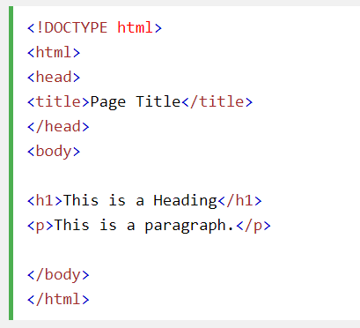
Typical HTML CODE

Slide 19
HTML5 image handling
<img src="pic_mountain.jpg" alt="Mountain View" style="width:304px;height:228px;">
Use width 100% to support responsive layout design.
Try: https://www.w3schools.com/html/tryit.asp?filename=tryhtml_images_trulli

Slide 20
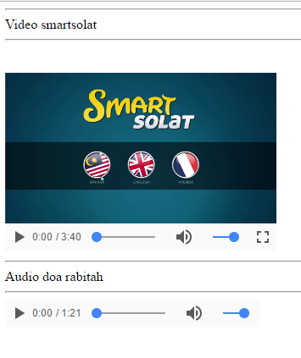
HTML5 Native video
<video width="320" height="240" controls> <source src="movie.mp4" type="video/mp4"> <source src="movie.ogg" type="video/ogg"> Your browser does not support the video tag. </video>
Try: https://www.w3schools.com/html/tryit.asp?filename=tryhtml5_video

Slide 21
HTML5 Native AUDIO
<audio controls> <source src="horse.ogg" type="audio/ogg"> <source src="horse.mp3" type="audio/mpeg"> Your browser does not support the audio element. </audio>

Slide 22
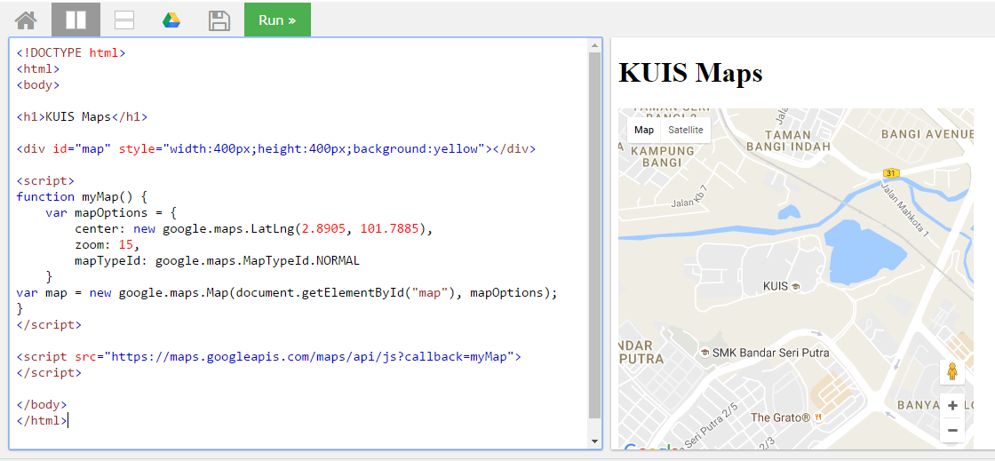
Location MAPS

Slide 23
T02 Bootstrap + Responsive Layout
FSTM KUIS

Slide 24
T02 BOOTSTRAP + RESPONSIVE LAYOUT
FSTM KUIS

Slide 25
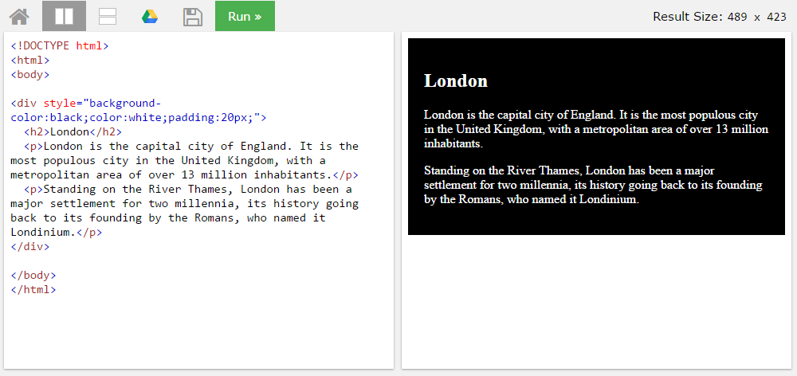
BLOCK <DIV>

Slide 26
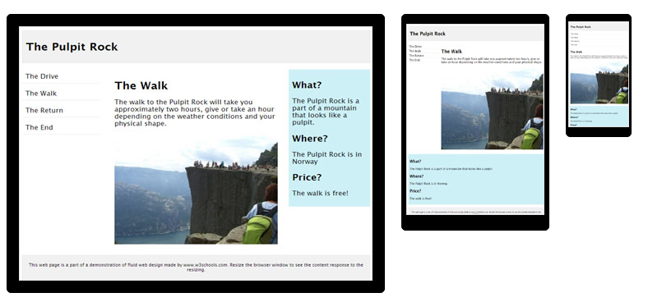
HTML Responsive layout

Slide 27
HTML Responsive layout
What is Responsive Web Design?
Responsive Web Design makes your web page look good on all devices (desktops, tablets, and phones).
Responsive Web Design is about using CSS and HTML to resize, hide, shrink, enlarge, or move the content to make it look good on any screen

Slide 28
VIEWPORT
<meta name="viewport" content="width=device-width, initial-scale=1">
The viewport varies with the device, and will be smaller on a mobile phone than on a computer screen.
The initial-scale=1.0 part sets the initial zoom level when the page is first loaded by the browser.

Slide 29
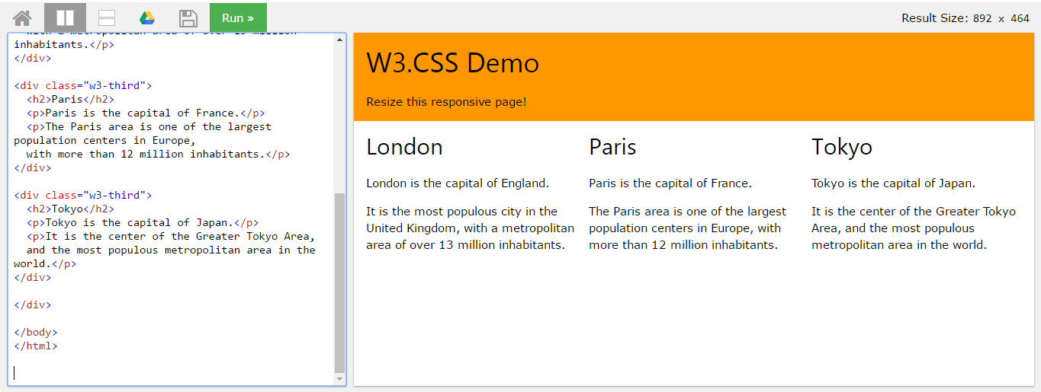
HTML Responsive layout

Slide 30
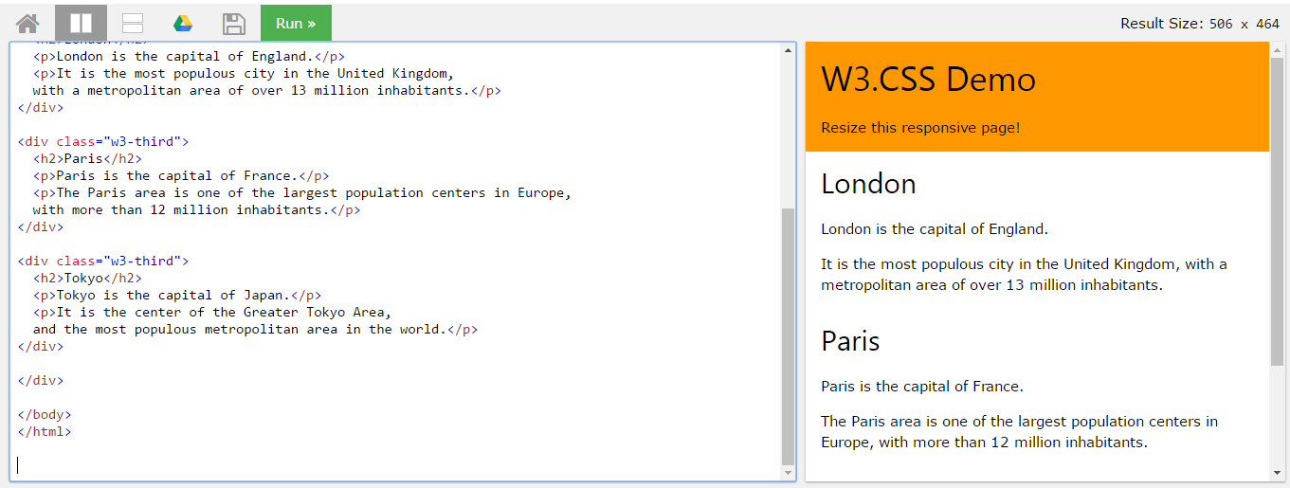
HTML Responsive layout

Slide 31

Bootstrap
A HTML framework supports responsive web design to provide one time webpage development for smartphone, tablet and desktop.

Slide 32
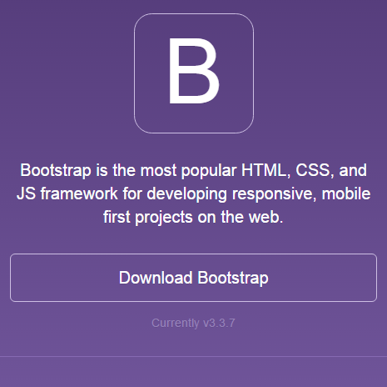
Bootstrap
Download framework from getbootstrap.com
OR use the CDN

Slide 33
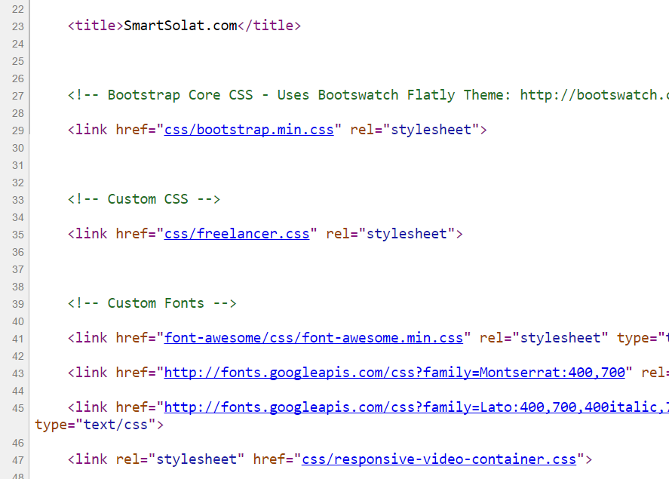
Bootstrap -setting
Copy the CSS script to the project folder.
> OR we can use CDN server

Slide 34
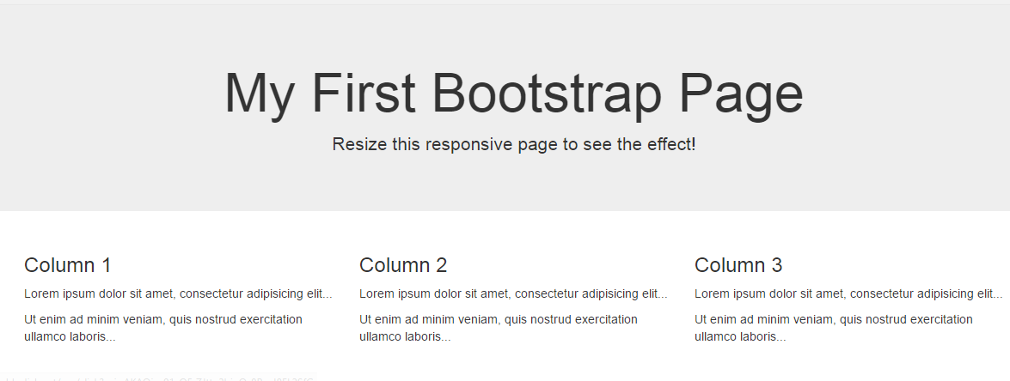
Basic bootstrap layout
Try it here http://www.w3schools.com/bootstrap/tryit.asp?filename=trybs_default&stacked=h

Slide 35
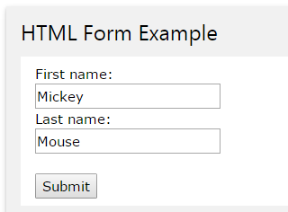
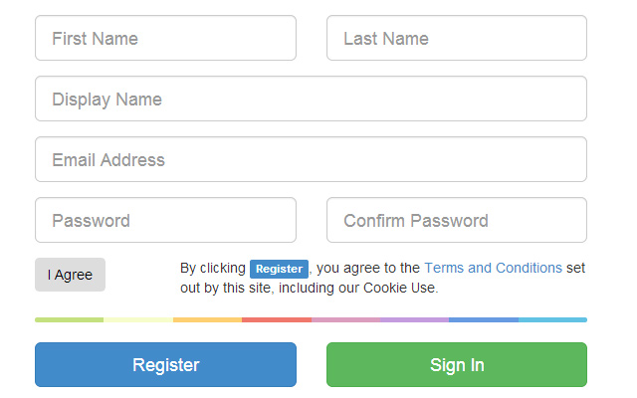
BOOTSTRAP FORM

Slide 36
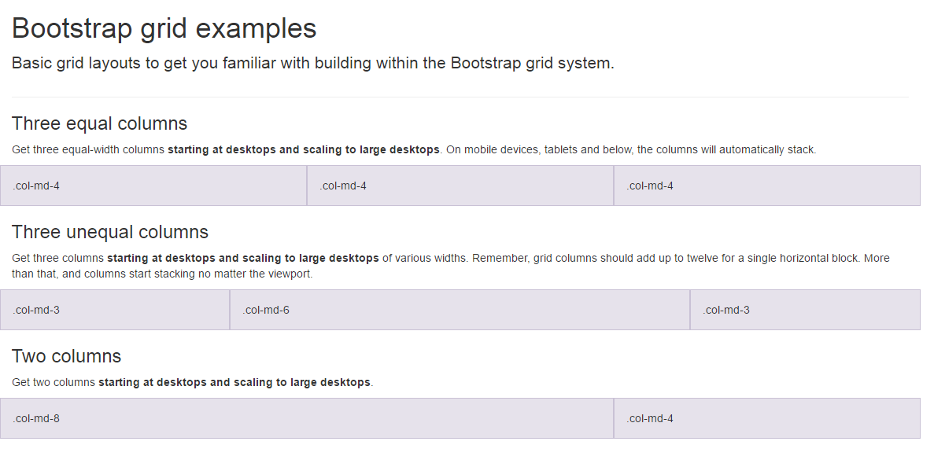
BootSTRAP GRID SYSTEM

Slide 37
BootSTRAP GRID SYSTEM DESKTOP
Banner
Main Content
Sidebar
Footer

Slide 38
BootSTRAP GRID SYSTEM MOBILE
Banner
Main Content
Sidebar
Footer

Slide 39
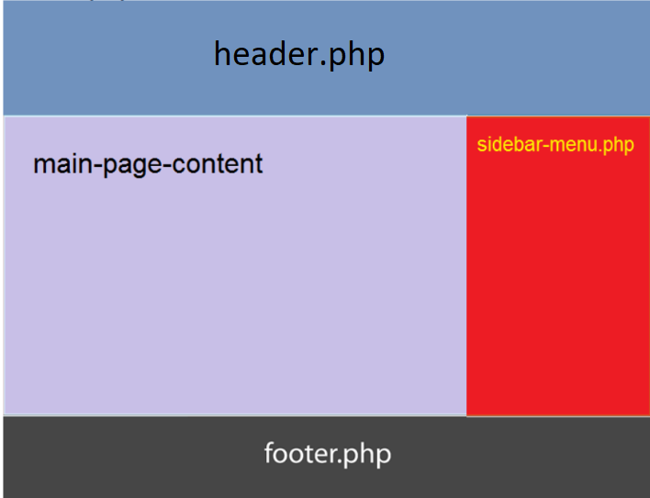
Include php
include (“header.php”);
<our content>
include (“footer.php”);

Slide 40

FREE STARTbootstrap.com
Example https://startbootstrap.com/

Slide 41
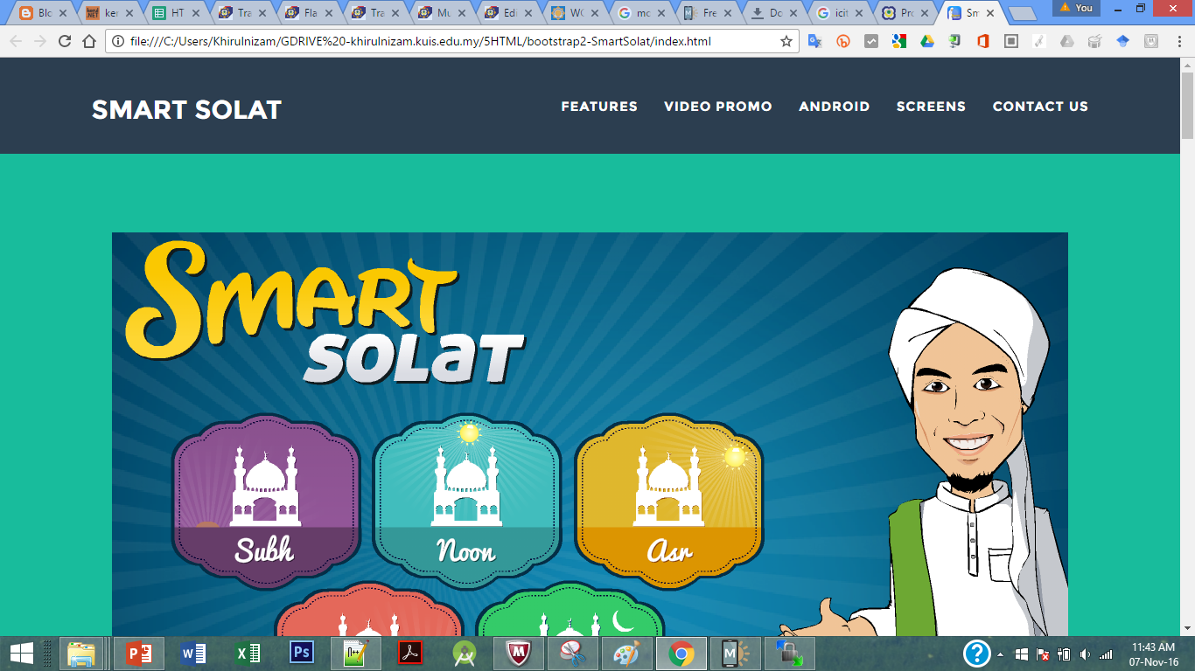
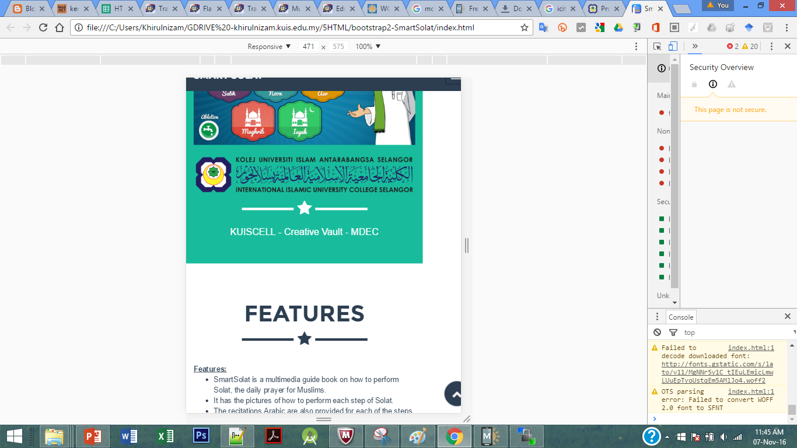
Sample2 - smartsolat

Slide 42
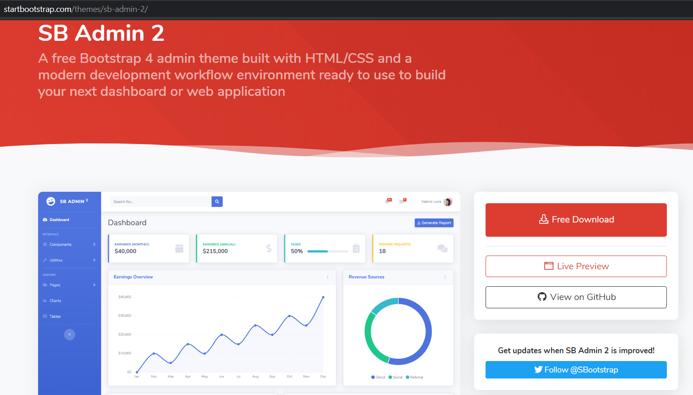
startbootstrap.com/themes/sb-admin-2/

Slide 43

T02.1 HTML + Bootstrap Form (Web Programming)
bit.ly/fstmtubephp

Slide 44
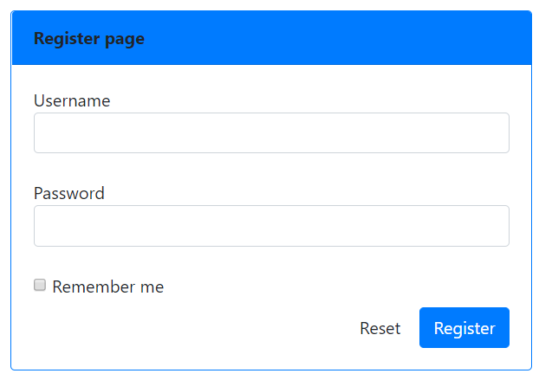
OUTPUT PREVIEW

Slide 45

DISCLAIMER
Codes are for demo purposes. Example showed here are only to validate the proof of concepts. Security aspect the demonstrated examples are beyond the coverage of these video tutorials. You are advised to explore / sought after advanced/security topics of PHP web programming as these tutorials only for beginner level.
Suitable to view in DESKTOP

Slide 46

CONNECT TO MYSQL DATABASE
mysqli
E-book PHP&Mysqli get it from
khirulnizam@gmail.com or
http://fb.com/khirulnizam or
Instagram @kerul_net
Video tutorial will cover mysqli

Slide 47
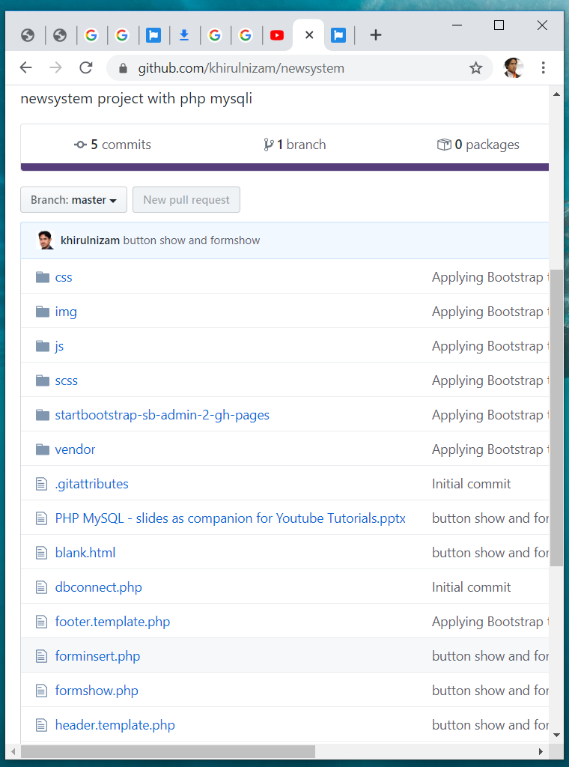

Code & Slides github.com/khirulnizam/ newsystem

Slide 48
BOOTSTRAP FORM

Slide 49
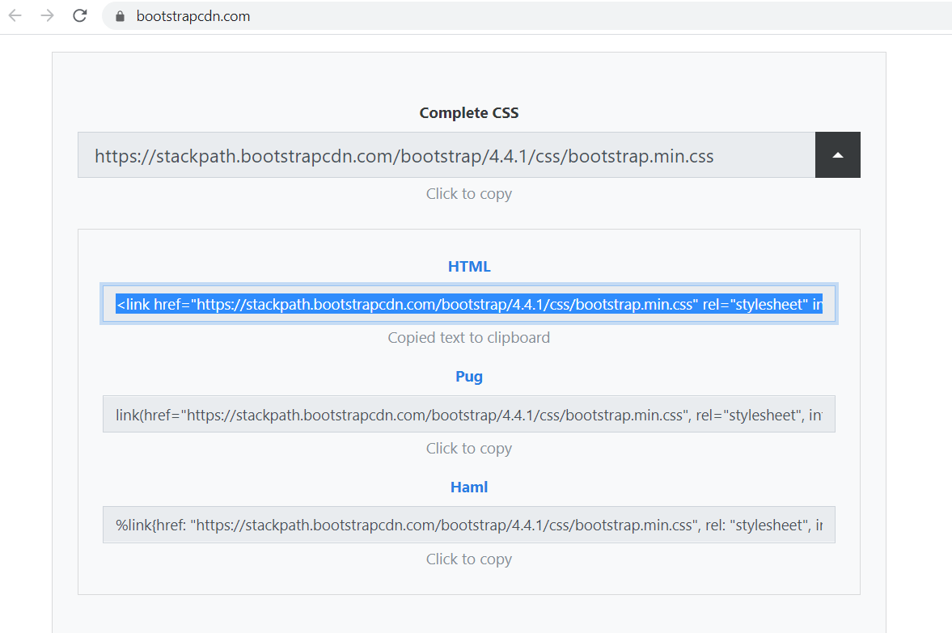
BootstrapCDN.com

Slide 50
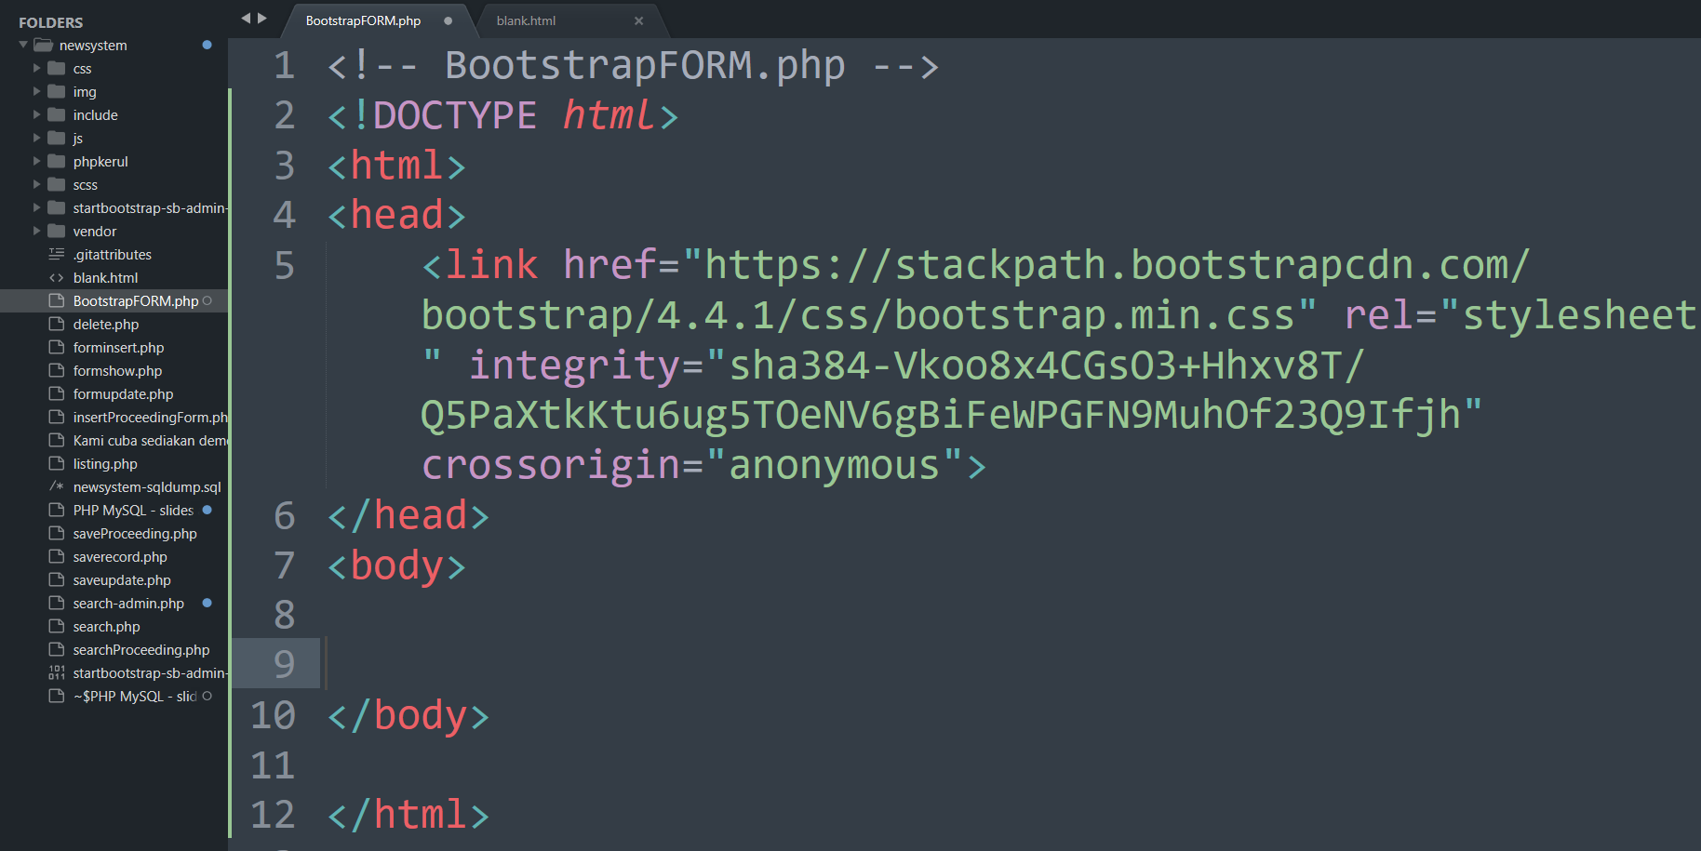

Slide 51
BootSTRAP GRID SYSTEM

Slide 52
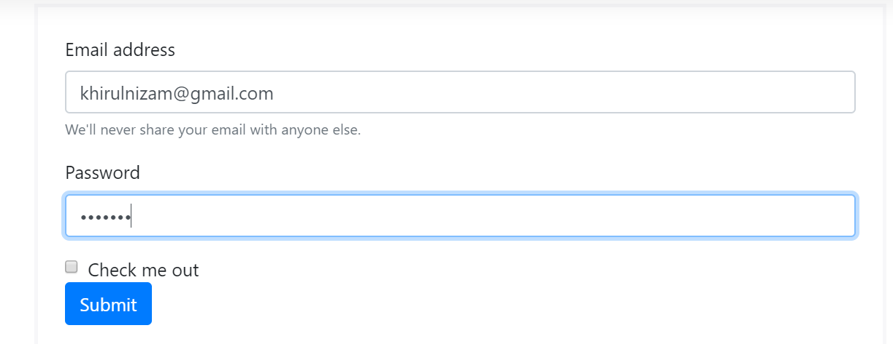
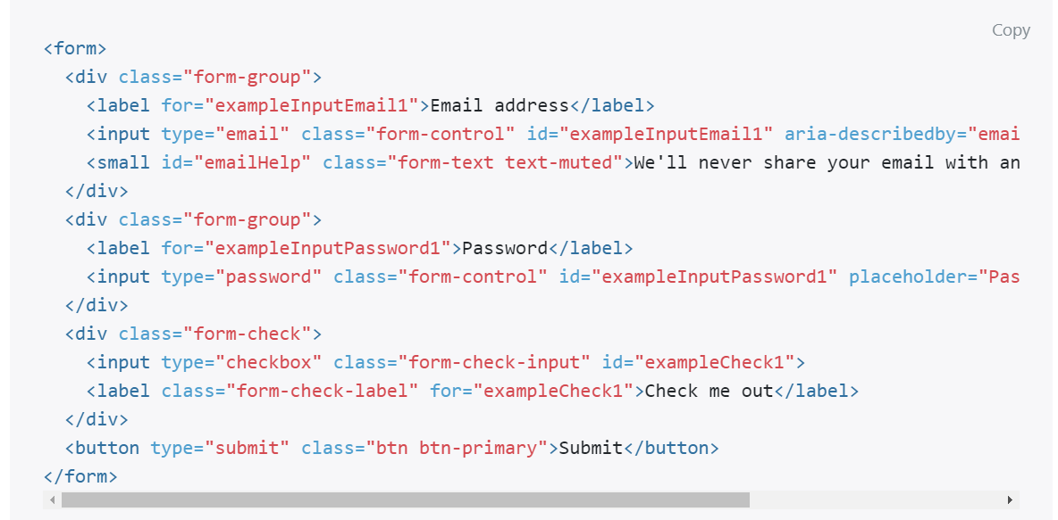
Email & PASSWORD

Slide 53
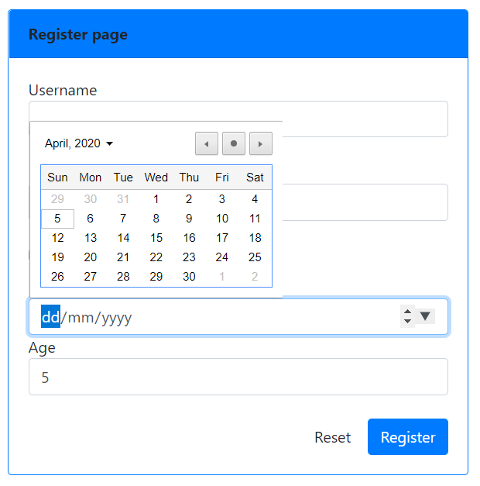
Date & NUMBER
<div >
Date of birth
<input type="date" name="dob" class="form-control">
Age
<input type="number" name="age" class="form-control">
</div>

Slide 54
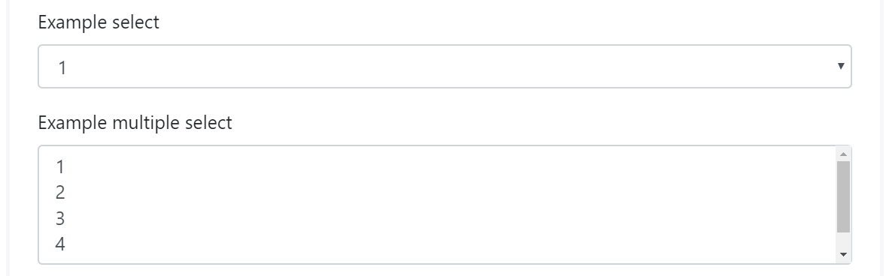
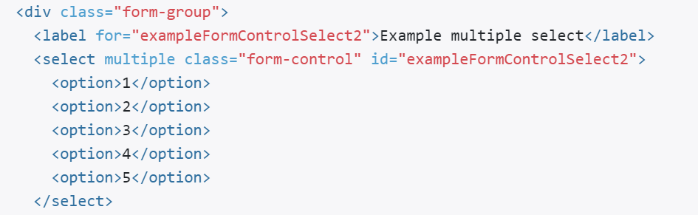
SELECT (DROP-DOWN)

Slide 55
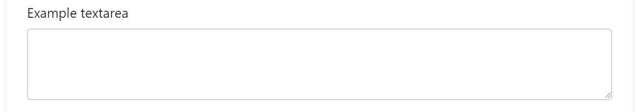
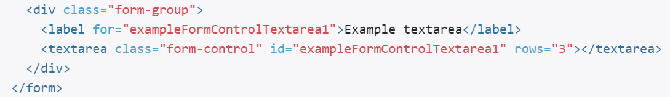
TEXTAREA

Slide 56
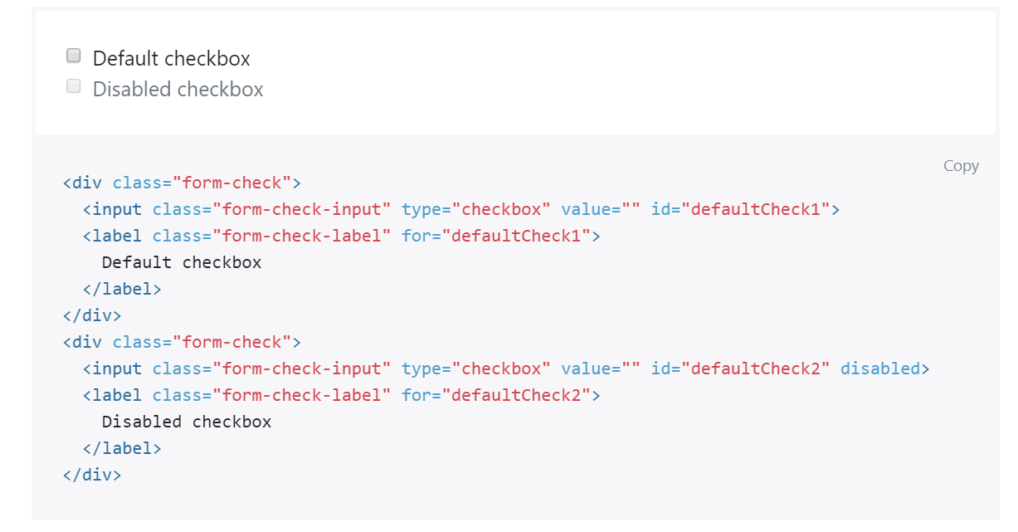
CHECKBOX

Slide 57
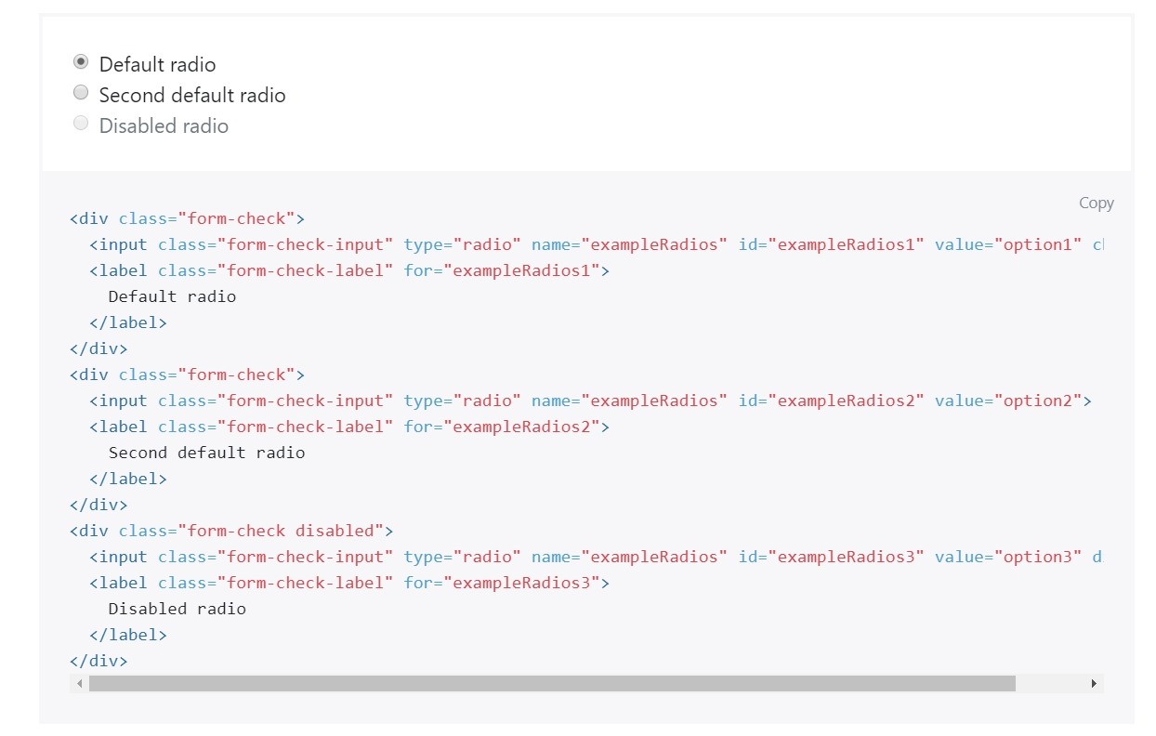
RADIO

Slide 58
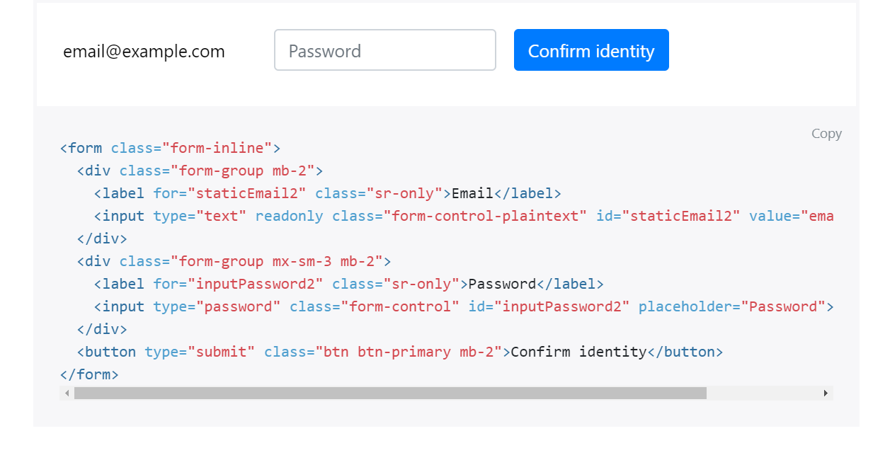
FORM-INLINE

Slide 59
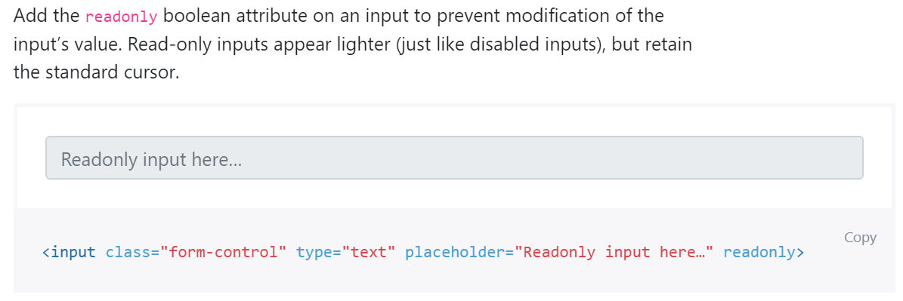
READONLY

Slide 60
DISABLED

Slide 61
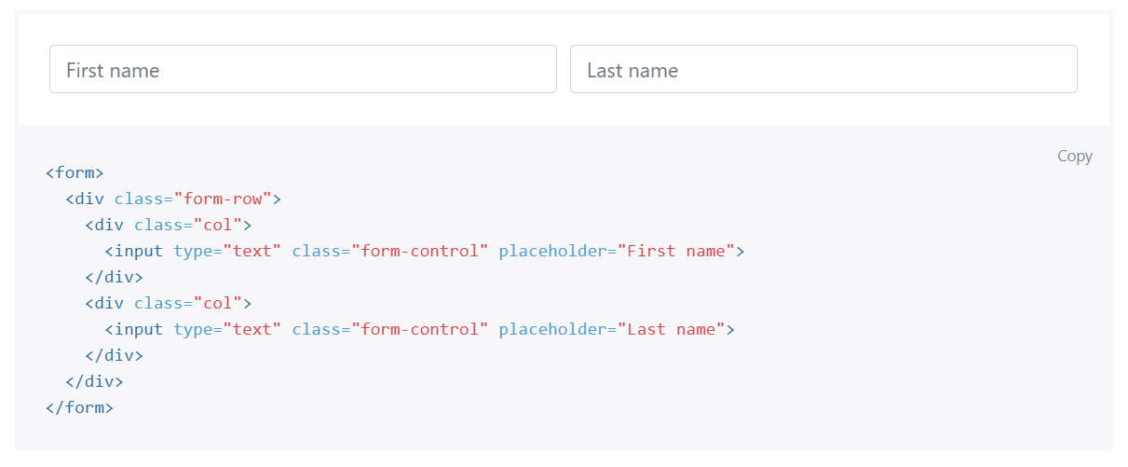
FROM GRID

Slide 62
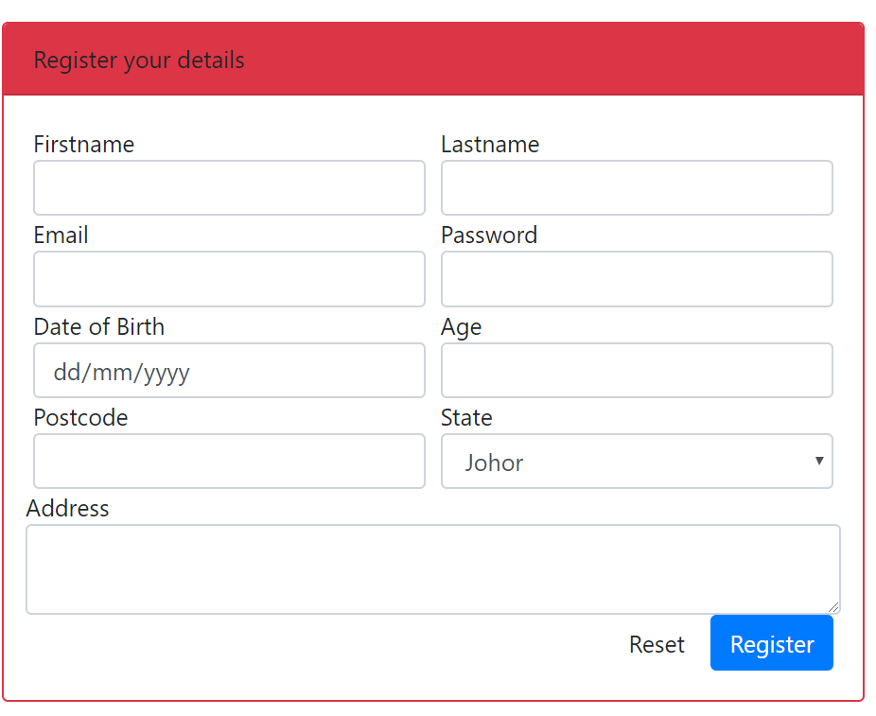
OUTPUT PREVIEW

Slide 63
T03: PHP syntax & echo T04: //comments T05: $variables & concat
w
bit.ly/fstmtube

Slide 64
Introduction
What is Web programming:
Combination of server-side and client-side to develop a dynamic website.
The application is deployed in the Web environment and can be access by multiple concurrent users.

Slide 65
Introduction to PHP
Server-side Scripting | Client-side scripting
The script embedded inside the HTML page, interpreted and executed inside the server (the web server) and the result/output of the execution is sent to the browser. The script interpreted and executed inside the server. E.g.: PHP, ASP, .NET, JSP | The script embedded inside the HTML page, downloaded with the HTML page and executed on the client (browser). E.g.: JavaScript.

Slide 66
Introduction to PHP
PHP= PHP: Hypertext Preprocessor:
Is a server-side scripting language.
PHP scripts are executed on the server, and the output from the process is inserted to the Web page as a part of the content before transmitted to the browser.
The script will not be sent to the browser which request the Web page, so the script is not visible to the users.

Slide 67
Introduction to PHP
Why PHP?
Runs on different platforms (Windows, Linux, Unix, etc.).
Is compatible with almost all servers used today (Apache, IIS, etc.).
Is free to download.
Is easier to learn and runs efficiently on the server side.

Slide 68
PHP Script Tag
A PHP scripting block always starts with <?php and ends with ?>
A PHP scripting block can be placed anywhere in the document.
On servers with shorthand support enabled ( enable in php.ini) may start a scripting block with <? and end with ?>

Slide 69
PHP Script Tag
A PHP file normally contains HTML tags, just like an HTML file, and some PHP scripting code.
Next, we have an example of a simple PHP script which sends the text “Assalamualaikum" to the browser:

Slide 70
PHP Script Tag
<html>
<head>
<title> Web Programming </title>
</head>
<body>
<?php
echo "Assalamualaikum";
?>
</body>
</html>

Slide 71
PHP Script TAG
Each code line in PHP must end with a semicolon ( ; ).
The semicolon is a separator and is used to distinguish one set of instructions from another.

Slide 72
PHP Script Tag
There are two basic statements to output text with PHP: echo and print.
In the example before, we have used the echo statement to output the text "Assalamualaikum".

Slide 73
PHP ECHO
<?php
$txt="Assalamualaikum!";
$x=23;
echo "Assalamualaikum!";
echo $x;
?>

Slide 74
T04 PHP SYNTAX //comment & $variable
FSTM KUIS

Slide 75
Comments in PHP
Comment is remark inside code that will not be compiled (ignored when the program is compiled).
It will not effect the code.
It is a good practice to write the comment.
Comment is useful the tell others what is the program is doing.
Helps programmer to memorize what is he doing.

Slide 76
Comments in PHP
In PHP, we use:
// to make a single-line comment or
/* … */ to make a large comment block.

Slide 77
Comments in PHP
<html>
<head>
<title> Web Programming </title>
</head>
<body>
<?php //This is a comment /* This is a comment block */ ?>
</body>
</html>

Slide 78
T05 SYNTAX PHP VARIABLES & CONCAT
w
FSTM KUIS

Slide 79
PHP Variables
Variables are used for storing values, like text strings, numbers or arrays.
When a variable is declared, it can be used over and over again in your script.
All variables in PHP start with a $ sign symbol.
The correct way of declaring a variable in PHP:
Eg: $var_name = "Kerul";

Slide 80
PHP Variables (cont)
New PHP programmers often forget the $
sign at the beginning of the variable.
In that case it will not work.
Let's try creating a variable, containing a string and a variable, containing a number:

Slide 81
PHP Variables (cont)
<?php
$txt="Assalamualaikum!";
$x=23;
echo $txt;
?>

Slide 82
EXAMPLE ON VARIABLE
Write the echo( )statement to display the following message:
Assalamualaikum!23

Slide 83
Naming Rules for Variables
A variable name must start with a $
A variable name can only contain alpha-numeric characters and underscores (a-z, A-Z, 0-9, and _ ).
A variable name should contain no space.
If a variable name is more than one word, it should be separated with an underscore ($my_string), or with capitalization ($myString).

Slide 84
EXAMPLE
Decide whether the following variables are valid or invalid. Give your reason.
$apa 11) $my_books
$123lekuk 12) $_myFamily
$what-is-the-number 13) $my address
$_uji1 14) $my2numbers
$my name
$For
IF
$float
$variable_to_hold_names_or_matrix_for_students
$hasil*nombor

Slide 85
Lateral Values
Lateral is the exact/actual value.
The value could be number (integer or real), character, string, or Boolean.

Slide 86
Lateral Values (cont)
Integer:
Integer is round number.
For example, 10 is an integer.
E.g.:
$num = 10;
$num = -10;
Use negative sign for negative numbers.

Slide 87
Lateral Values (cont)
Float:
E.g.:
$temp = 21.1225;
$product = 0.0;

Slide 88
Lateral Values (cont)
Characters:
To assign a character value into a char variable, the value must be put inside a open and close single or double quote.
E.g.:
$nama = 'Encik';
$name = "Kerul";

Slide 89
Lateral Values (cont)
Boolean:
There are only two values for Boolean variable: true and false.
E.g.:
$eatalready = true;
$isInteger = false;

Slide 90
Lateral Values (cont)
String:
A group of characters.
Marked with single or double quote.
E.g.:
$stmt = "How are you";

Slide 91
Concatenation Operator
There is only one string operator in PHP.
The concatenation operator ( . ) is used to put two string values together.
To concatenate two string variables together, use the concatenation operator:
String name;

Slide 92
Concatenation (cont)
<?php $txt1="Assalamualaikum!"; $txt2="Have a nice day!";
$name=“kerul”; echo $txt1 . " " . $txt2; ?>

Slide 93
Concatenation (cont)
The simpler way in doing concatenation:
<?php $txt1="Assalamualaikum!"; $txt2="Have a nice day!";
echo "$txt1 $txt2"; ?>

Slide 94
Concatenation (cont)
Or, if you want to print the output in a separate line:
<?php $txt1="Assalamualaikum!"; $txt2="Have a nice day!";
echo "$txt1 <br> $txt2"; ?>

Slide 95
Concatenation (cont)
Array:
<?php $num[0]=3;
echo "Number ".$num[0];
echo "Number $num[0] ";//not possible
?>

Slide 96
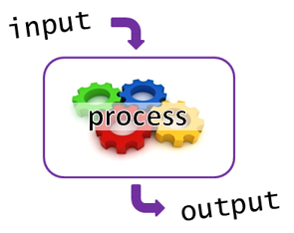
T05+1 Input Process Output
bit.ly/fstmtube

Slide 97
I-P-O
Input data
Process the data by converting into information
Output – convey the information as something meaningful

Slide 98
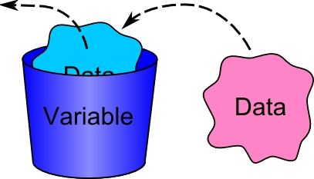
PHP Variables
Variables are used for storing values, like text strings, numbers or arrays.
All variables in PHP start with a $ sign symbol.
The correct way of declaring a variable in PHP:
Eg: $num1= 3; $num2=5;

Slide 99
Naming Rules for Variables
A variable name must start with a $
A variable name can only contain alpha-numeric characters and underscores (a-z, A-Z, 0-9, and _ ).
A variable name should contain no space.
If a variable name is more than one word, it should be separated with an underscore ($my_string), or with capitalization ($myString).

Slide 100
Arithmetic Operations
Operator | Operation | Example
 |  | Mathematical expression | PHP expression
+ | Addition | num1 + 3 | $total=$n1 + $n2;
- | Subtraction | pi - y | $q=$pi - $y;
* | Multiplication | width x height | $area=$width * $height;
/ | Division | a/b | $div=$a/$b;
% | Modulus | num modulo 2 | $even=$nom%3;

Slide 101
PROCESS: ADD 2 NUMBERS
Input process output
$num2 3
$num1 5
$total 8

Slide 102
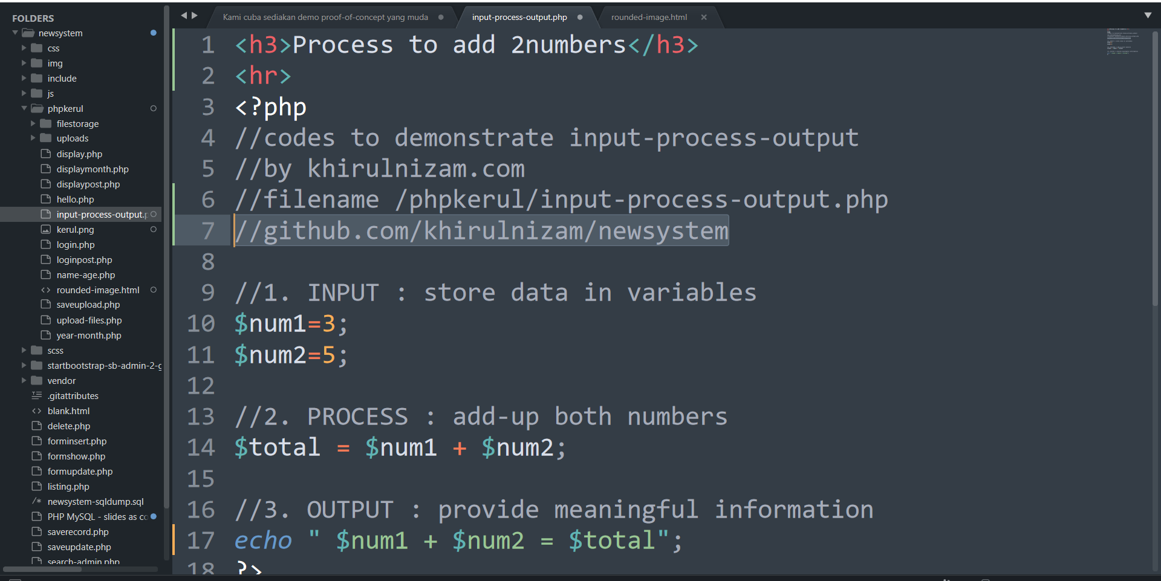
github.com/khirulnizam/newsystem

Slide 103





T06 INPUT FORM
FSTM KUIS

Slide 104
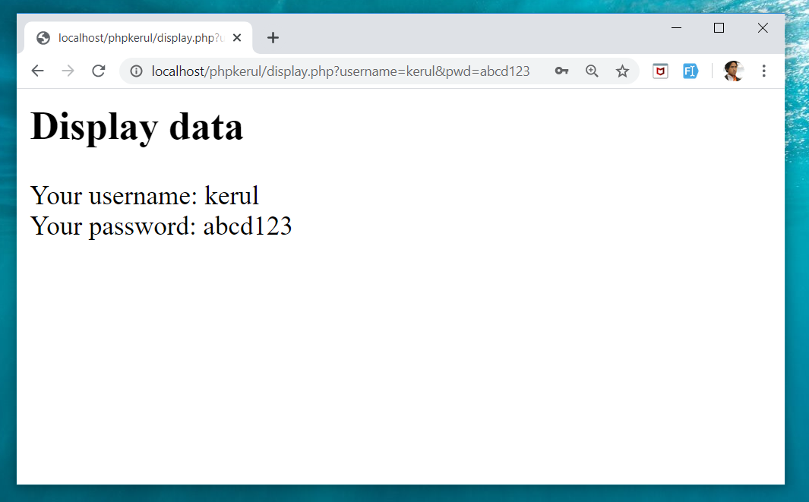
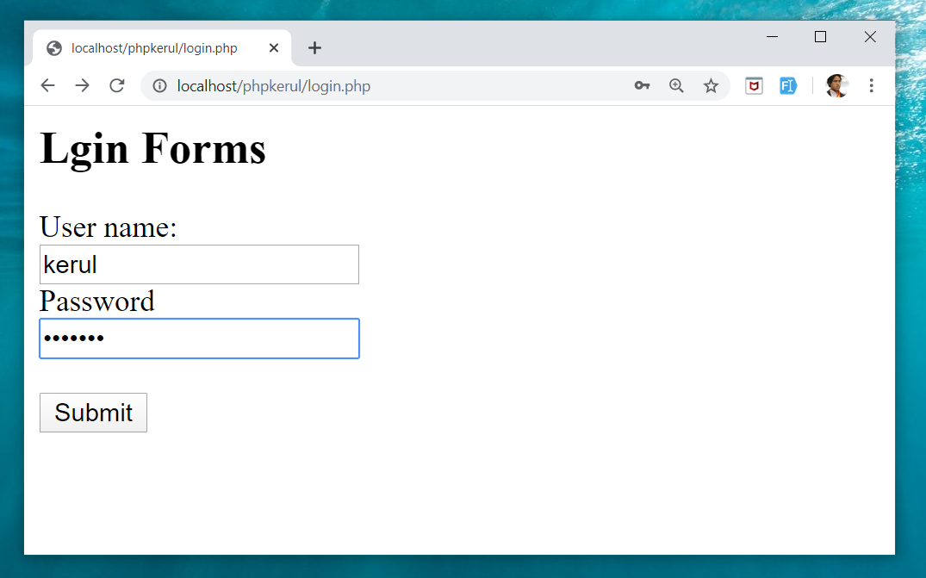
Example (cont)
display.php
login.php

Slide 105
Input Through HTML
<form name= "aform" method= "GET" action= "save.php" >
input…
</form>
This is the typical structure of form:
name: is the name of the form.
method: how the data is transferred (POST or GET).
action: is the target file resides in the Web server that receive the data from the form.
input: are the input elements (text field, checkbox, radio button, etc.).

Slide 106
GET vs. POST
GET | POST
Is basically for just getting (retrieving) data. The variable name and the value appear and visible in the URL. Form data is to be encoded (by a browser) into at the end of the URL of the target file. | Form data is embedded within a message body. POST may involve anything, like storing files to the server, updating data, ordering a product, or sending an e-mail. The variable name and the value do not appear in the URL.

Slide 107
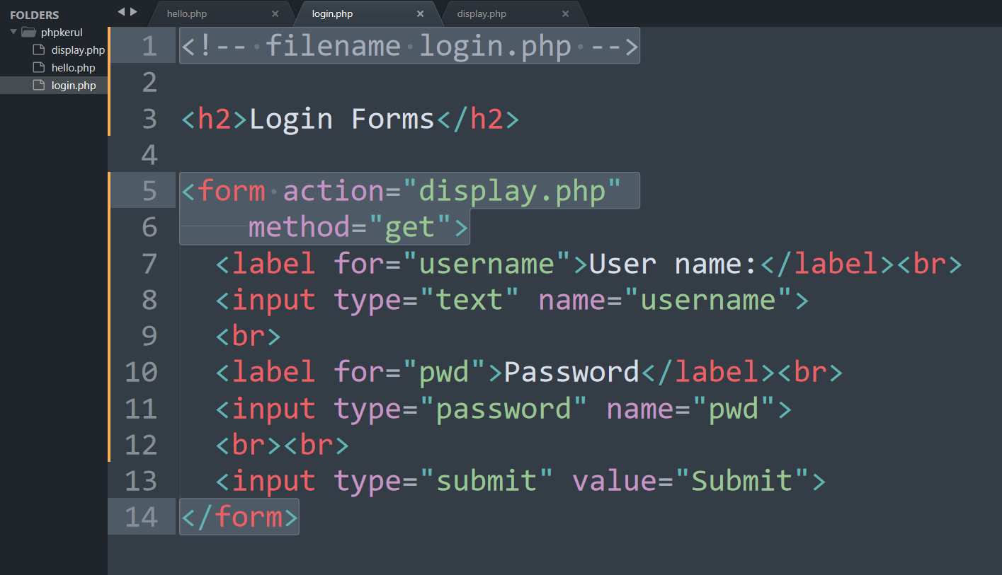
Example (Using GET Method)

Slide 108
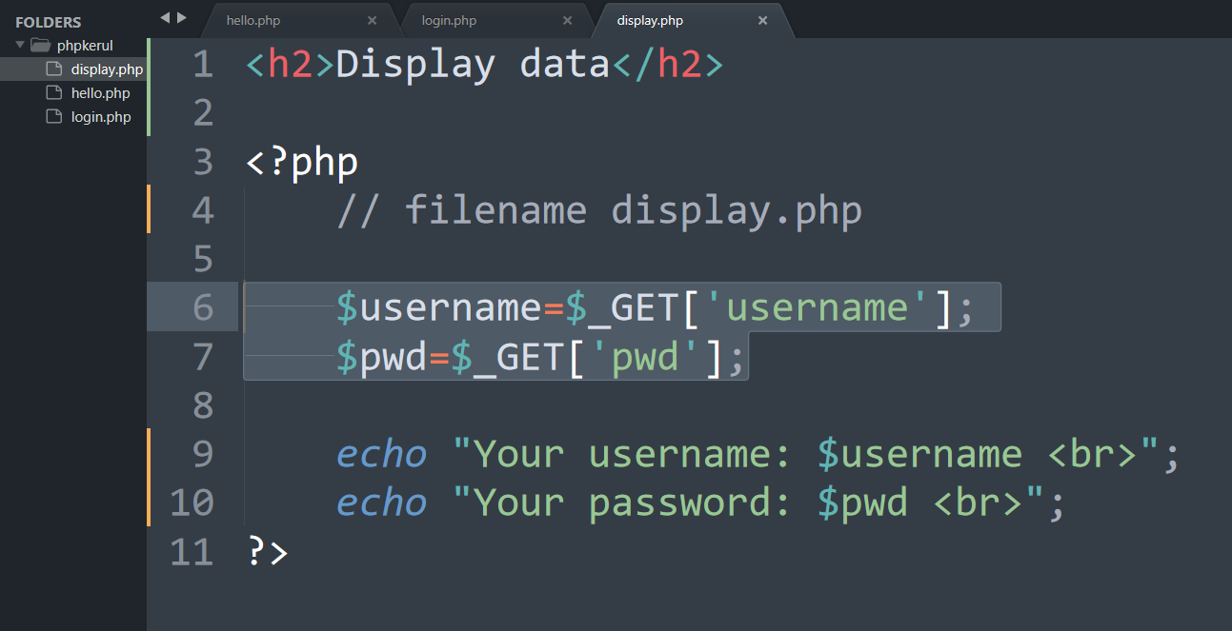
Display.php

Slide 109
Example (cont)

Slide 110
Example (Using POST Method)

Slide 111
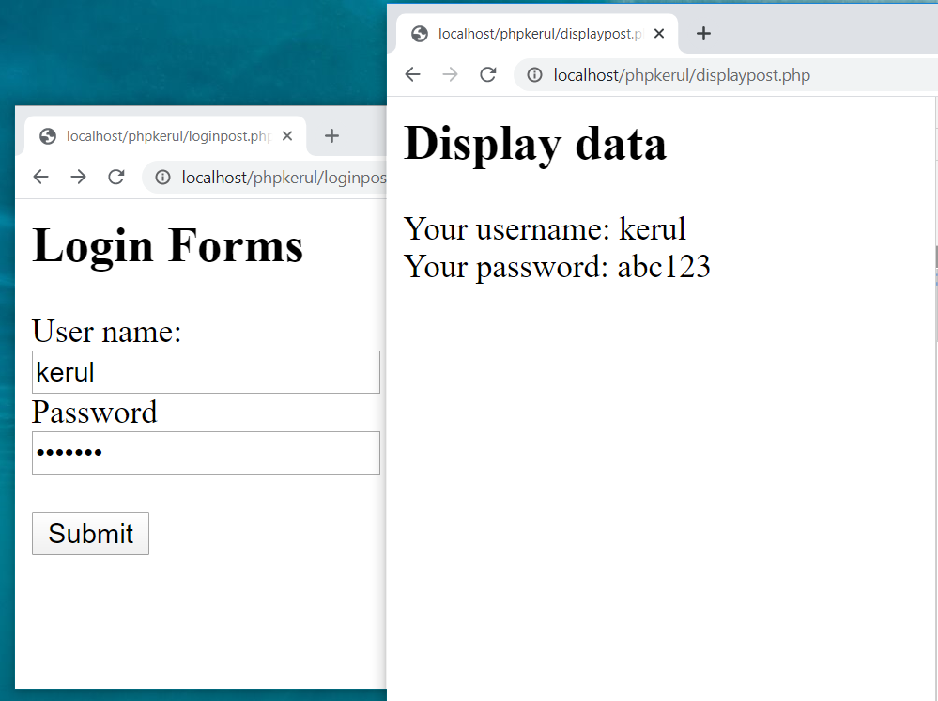

Slide 112
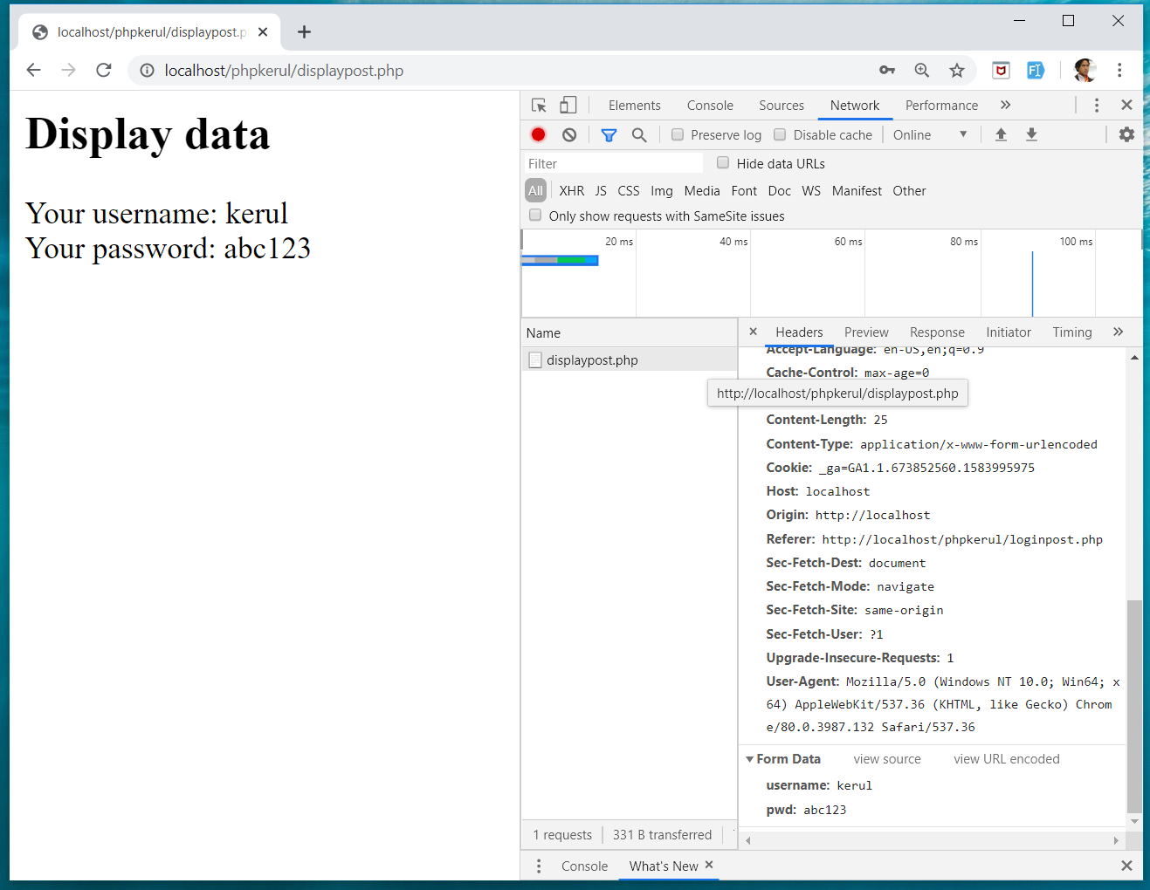
INSPECT TOOLS
F12

Slide 113
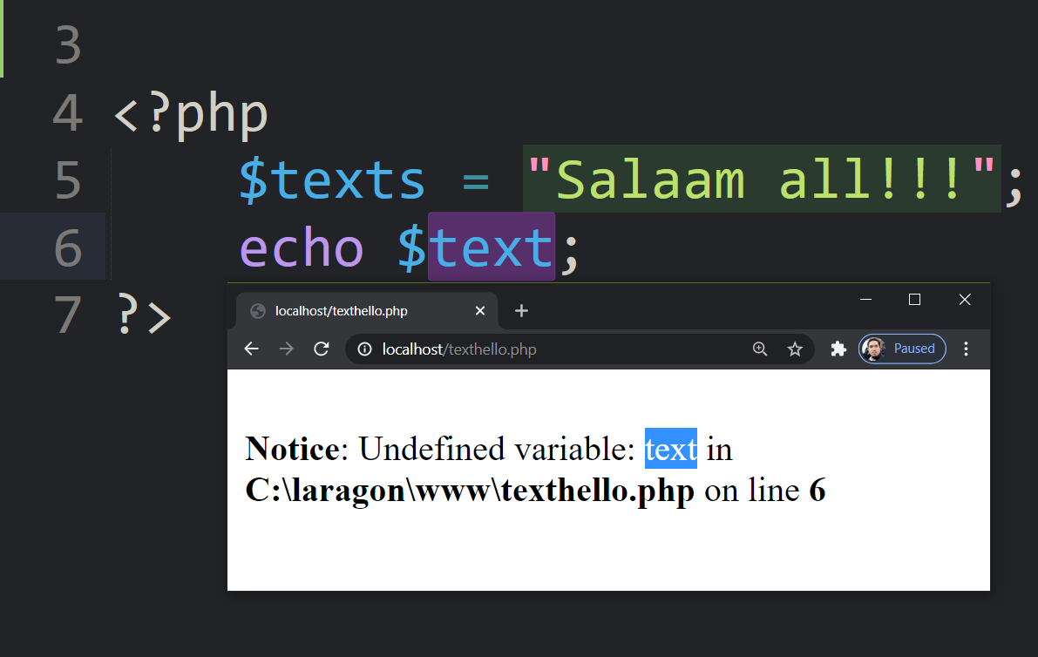
bit.ly/fstmkuis

Slide 114
if else SELECTION (Lecture Chapter06)
FSTM KUIS

Slide 115
Comparison Operators
Operator | Meaning | Example
== | Equal to | ($num == 100)
!= | Not equal to | ($letter != ‘Z’)
< | Less than | ($num1 < $num2)
> | Greater than | ($mark > 80)
<= | Less than or equal to | ($sum <= 10)
>= | Greater than or equal to | ($sum >= $input)

Slide 116
Selection in PHP
if is a PHP reserved words to perform selection:
Simple if: for one choice selection
if…else: for two choices selection

Slide 117
Simple if
E.g.:
if ($grade == 'A')
echo 'Excellent';
else if ($grade == 'F')
echo 'Try again’;
else

Slide 118
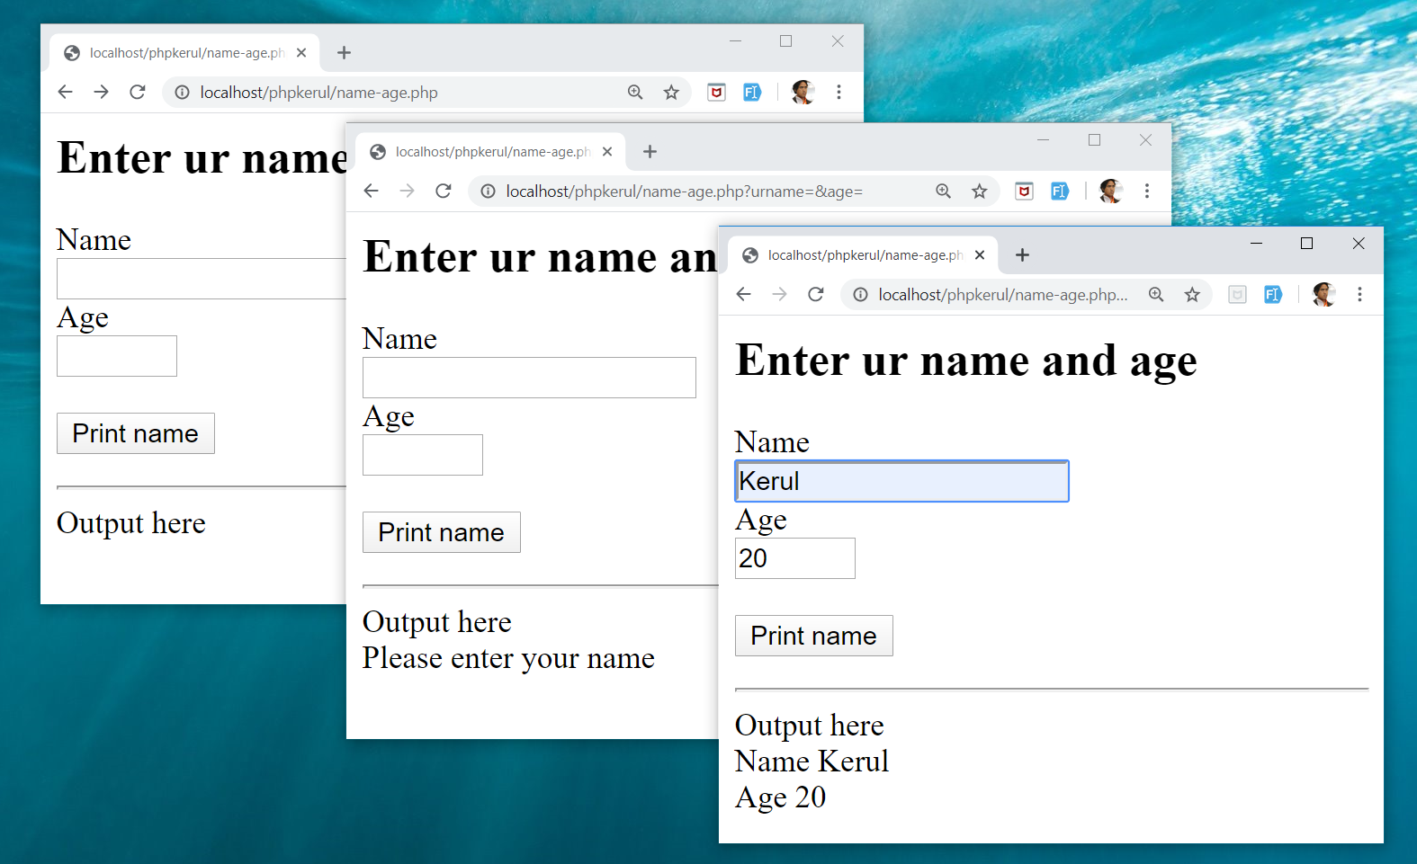
Example

Slide 119
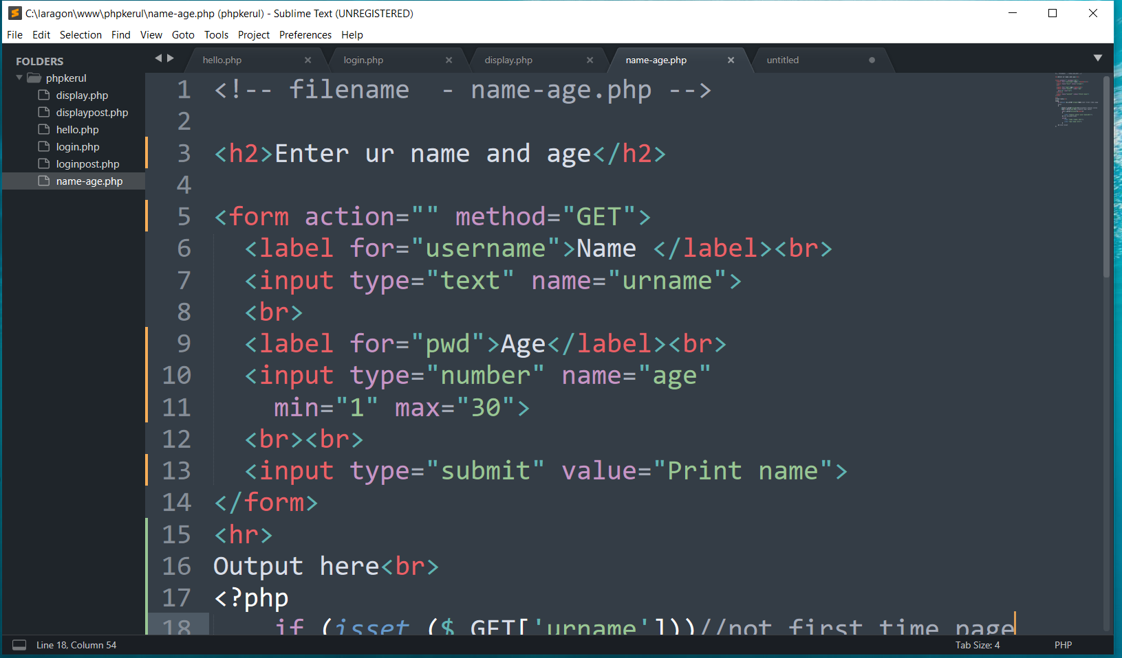
FORM (name-age.php )

Slide 120

THE PHP IF…ELSE

Slide 121
ITERATION (LECTURE CHAPTER07)
FSTM KUIS

Slide 122
Repetition in PHP
There are many ways of doing repetition. Three of them:
for
while and do…while
foreach

Slide 123

for structure
E.g.:
<?php
for ($i=1;$i<=9;$i++){
echo "$i<br>";
}
?>

Slide 124

OUTPUT SAMPLE

Slide 125


DISPLAY YEARS in DROPDOWN

Slide 126

SELECT
OPTION

Slide 127
T09 ARRAY (Eng)
FSTM KUIS

Slide 128
Introduction of Array
A variable is a storage area holding a number or text. The problem is a variable hold only one value.
An array is a special variable, which can store multiple values in one single variable.

Slide 129
Introduction of Array (cont)
If you have a list of items (a list of student names, for e.g.), storing the student names in single variables could look like this:
$std1="Anas"; $std2="Hajar"; $std3="Shah";

Slide 130
Introduction of Array
In PHP, there are 3 kind of arrays:
Numeric array - An array with a numeric index.
Assign using AUTOMATIC method.
Assign using MANUAL method.
Associative array - An array where each ID key is associated with a value.
Multidimensional array - An array containing one or more arrays.

Slide 131
Numeric Array
Assign using AUTOMATIC method (change index starts at 1).
$month = array(1=>"Jan", "Feb", "March",
"April", "May", "June");
index | $month[1] | $month[2] | $month[3] | $month[4] | $month[5] | $month[6]
value | Jan | Feb | March | April | May | June

Slide 132
NUMERIC ARRAY
Assigning array with values using MANUAL method.
$month[1]="Jan"; $month[2]="Feb"; $month[3]="March"; $month[4]="April";

Slide 133
Example
<?php
$std[0]="Anas";
$std[1]="Hajar";
$std[2]="Shah";
$std[3]="Nurul";
echo $std[0] . " and " . $std[1] . " are students of FSTM.";
?>

Slide 134

Associative Array
$record['rollno']=5;
$record['name']="Kerul";
$record['phone’]=90346;

Slide 135
SELECT
OPTION

Slide 136

FOREACH

Slide 137
Pengulangan
for{i=1; i<=3000; i++}

Slide 138

for{i=1; i<=3000; i++}
khirulnizam.com

Slide 139
T10 FILE UPLOAD (MUAT-NAIK FAIL)
w
bit.ly/fstmtube

Slide 140
DISCLAIMER
Codes are for demo purposes. Example showed here are only to validate the proof of concepts. Security aspect the demonstrated examples are beyond the coverage of these tutorials. You are advised to explore / sought after advanced topics of PHP web programming as the issues are covered in the advanced level.

Slide 141
move_uploaded_file function
The move_uploaded_file() function moves an uploaded file to a new location.
This function returns TRUE on success, or FALSE on failure.
Syntax:
move_uploaded_file(file,newloc)
file: Specifies the file name.
newloc: Specifies the new location (destination) for the file.

Slide 142
PHP.ini
In php settings ( locate file php.ini from Laragon), turn-on the file upload
file_uploads = On

Slide 143
UPLOAD FORM (ONLY FOR IMAGE)
<!DOCTYPE html> <html> <body> <form action= "saveupload.php" method="post" enctype="multipart/form-data"> Select image to upload: <input type="file" name="fileToUpload" <input type="submit" value="Upload Image" name="submit"> </form> </body> </html>

Slide 144

enctype
enctype="multipart/form-data" - POST request with file-upload, have to encode the data that forms the body of the request.
<input name="fileToUpload" type="file" > - the form control to choose a file and upload to server.

Slide 145

OUTPUT

Slide 146

PHP to store image in server
Source: www.w3schools.com/php/php_file_upload.asp

Slide 147

PHP to store image in server
Source: www.w3schools.com/php/php_file_upload.asp

Slide 148

PHP to store image in server
Source: www.w3schools.com/php/php_file_upload.asp

Slide 149
OUTPUT

Slide 150

T11 php OOP (PENGATURCARAAN BERASASKAN OBJEK)
bit.ly/fstmtube

Slide 151





OOP
Object Oriented Programming - We can imagine our surroundings are full of objects cars, trees, houses, etc. Same way there is object oriented programming concepts which assume everything as an object and implement a software/system parts using different objects.
w3schools

Slide 152



FUNCTION IN PHP
A function is a block of statements that can be used repeatedly in a program.
Without arguments.
With arguments.

Slide 153
MODULAR PHP FUNCTION
Tokenization
Post Tagging
Vocab
Outside Vocab
Annotati
Output generation
Input file

Slide 154
Class
PHP OOP
Methods
Properties
Classes and objects are the two main aspects of object-oriented programming.
Class
Method/function
Object call
Constructor
Static method/property
Inheritance

Slide 155

PHP Class

Slide 156

CLASS Method

Slide 157


PHP Class with Constructor

Slide 158
PHP Object Call

Slide 159


STATIC METHOD/PROPERTIES
w3schools

Slide 160

INHERITANCE
Inheritance in OOP = When a class derives from another class.
The child class will inherit all the public and protected properties and methods from the parent class. In addition, it can have its own properties and methods.
An inherited class is defined by using the extends keyword.
Parent /
Superclass
Child/Subclass

Slide 161

EXAMPLE ON INHERITANCE

Slide 162

INHERITANCE: PHP FRAMEWORK
bit.ly/fstmtubelaravel

Slide 163

T12 PREPARING MYSQL DATABASE SERVER (PANGKALAN DATA)
bit.ly/fstmtubephpmysql

Slide 164

T12 PREPARING MYSQL DATABASE SERVER (PANGKALAN DATA)
bit.ly/fstmtubephpmysql

Slide 165
DISCLAIMER
Codes are for demo purposes. Example showed here are only to validate the proof of concepts. Security aspect the demonstrated examples are beyond the coverage of these tutorials. You are advised to explore / sought after advanced/security topics of PHP web programming as these tutorials only for beginner level.

Slide 166
CONNECT TO MYSQL DATABASE
mysqli/PDO
E-book PHP&Mysqli get it from
khirulnizam@gmail.com or
http://fb.com/khirulnizam or
Instagram @kerul_net
These vids tutorial will cover mysqli/PDO

Slide 167

CHANGE DBSERVER ROOT PASSWORD

Slide 168

ENTER PASSWORD

Slide 169


START ALL

Slide 170


CREATE NEW DB

Slide 171

HEIDI SQL (MYSQL CILENT)

Slide 172

CREATE NEW TABLE
Right-click on dbname

Slide 173

TABLE STRUCTURE : STUDENTS
Table name: students
set auto_increment for field id

Slide 174

POPULATE DUMMY DATA
Right-click to insert new row

Slide 175
T13 DBCONNECT PDO (PANGKALAN DATA PDO)
bit.ly/fstmtubephpmysql

Slide 176
T13 DBCONNECT PDO (PANGKALAN DATA PDO)
bit.ly/fstmtubephpmysql

Slide 177
DISCLAIMER
Codes are for demo purposes. Example showed here are only to validate the proof of concepts. Security aspect the demonstrated examples are beyond the coverage of these tutorials. You are advised to explore / sought after advanced/security topics of PHP web programming as these tutorials only for beginner level.

Slide 178
CONNECT TO MYSQL DATABASE
mysqli/PDO
E-book PHP&Mysqli get it from
khirulnizam@gmail.com or
http://fb.com/khirulnizam or
Instagram @kerul_net
These vids tutorial will cover mysqli/PDO

Slide 179

WHY PDO ?
PDO – PHP Data Object
Support different database
mysqli – only for MySQL
database connection
https://www.php.net/manual/en/book.pdo.php

Slide 180

TEST DBCONNECT TO DATABASE

Slide 181

HOW TO DISPLAY ALL RECORDS

Slide 182

EMBED SQL STATEMENT

Slide 183

SUBSCRIBE FSTM KUIS CHANNEL

Slide 184
T14 DBCONNECT using mysqli (Pangkalan Data mysqli)
bit.ly/fstmtubephpmysql

Slide 185
STAY HOME5, SAVE MALAYSIA! t14: mysqli
bit.ly/fstmphpmysqli

Slide 186
Database & RECORD LISTING (Eng Lecture Chapter 08-09)
FSTM KUIS

Slide 187
DISCLAIMER
Codes are for demo purposes. Example showed here are only to validate the proof of concepts. Security aspect the demonstrated examples are beyond the coverage of these tutorials. You are advised to explore / sought after advanced/security topics of PHP web programming as these tutorials only for beginner level.
Suitable to view in DESKTOP

Slide 188
CONNECT TO MYSQL DATABASE
mysqli
E-book PHP&Mysqli get it from
khirulnizam@gmail.com or
http://fb.com/khirulnizam or
Instagram @kerul_net
These vids tutorial will cover mysqli

Slide 189
3-tier – DATABASE CONNECTION
Tier3 : Database
Tier1 : Client/browser
Tier2 : Middleware (Webserver + PHP)

Slide 190
START ALL

Slide 191

CREATE NEW DB

Slide 192
CREATE NEW TABLE
Right-click on dbname

Slide 193
TABLE STRUCTURE : STUDENTS
Table name: students
set auto_increment for field id

Slide 194
POPULATE DUMMY DATA
Right-click to insert new row

Slide 195

PREPARE DATABASE NAME & TABLE

Slide 196
mysqli_connect ( )
<?php
$servername = "localhost";//server location / IP number
$username = "root";//db admin username
$password = "abcd1234";//password for db admin username
$dbname = "newsystem";//database name
// Create connection
$conn = mysqli_connect($servername, $username,
$password, $dbname);

Slide 197

mysqli_connect ( )

Slide 198

TEST SQL COMMANDS

Slide 199
MSQLI FUNCTIONS
$result = mysqli_query($conn, $sql)
PHP.net/mysqli_query : Performs an SQL query on the database
if (mysqli_num_rows($result) > 0)
PHP.net/mysqli_num_rows : Gets the number of rows in a result
while($row = mysqli_fetch_assoc($result)) {
PHP.net/mysqli_fetch_assoc : Fetch a result row as an associative array

Slide 200
Associative Array
$record['rollno']=4;
$record['name']="Jhon";
$record['phone']=456785;

Slide 201

EMBED SQL IN PHP

Slide 202

DISPLAY RESULT SET

Slide 203
SUBSCRIBE FSTM KUIS CHANNEL

Slide 204
T15 SEARCH IN DB (Carian dalam DB)
bit.ly/fstmtubephpmysql

Slide 205
SEARCH RECORD (Chapter 10 - English)
FSTM KUIS

Slide 206
DISCLAIMER
Codes are for demo purposes. Example showed here are only to validate the proof of concepts. Security aspect the demonstrated examples are beyond the coverage of these video tutorials. You are advised to explore / sought after advanced/security topics of PHP web programming as these tutorials only for beginner level.
Suitable to view in DESKTOP

Slide 207
CONNECT TO MYSQL DATABASE
mysqli
E-book PHP&Mysqli get it from
khirulnizam@gmail.com or
http://fb.com/khirulnizam or
Instagram @kerul_net
Video tutorial will cover mysqli

Slide 208
Code & Slides github.com/khirulnizam/ newsystem

Slide 209

CODE: search.php

Slide 210

POPULATE DATA INSIDE TABLE

Slide 211
Next

Slide 212

T16 BOOTSTRAP TEMPLATE
bit.ly/fstmtphpmysqli

Slide 213
BOOTSTRAP INTERFACE (English)
FSTM KUIS

Slide 214
EXAMPLE OF IMPLEMENTATION

Slide 215
GITHUB
https://github.com/khirulnizam/newsystem

Slide 216
DISCLAIMER
Codes are for demo purposes. Example showed here are only to validate the proof of concepts. Security aspect the demonstrated examples are beyond the coverage of these video tutorials. You are advised to explore / sought after advanced/security topics of PHP web programming as these tutorials only for beginner level.
Suitable to view in DESKTOP

Slide 217
CONNECT TO MYSQL DATABASE
mysqli
E-book PHP&Mysqli get it from
khirulnizam@gmail.com or
http://fb.com/khirulnizam or
Instagram @kerul_net
Video tutorial will cover mysqli

Slide 218
Include php
include ("header.php");
<our content>
include ("footer.php");

Slide 219
startbootstrap.com/themes/sb-admin-2/

Slide 220
EXAMPLE OF IMPLEMENTATION

Slide 221

T17 INSERT RECORD (MASUKKAN REKOD BAHARU)
bit.ly/fstmtphpmysqli

Slide 222
INSERT RECORD (Chapter 11 English)
FSTM KUIS

Slide 223
EXAMPLE OF IMPLEMENTATION

Slide 224
GITHUB
https://github.com/khirulnizam/newsystem

Slide 225
DISCLAIMER
Codes are for demo purposes. Example showed here are only to validate the proof of concepts. Security aspect the demonstrated examples are beyond the coverage of these video tutorials. You are advised to explore / sought after advanced/security topics of PHP web programming as these tutorials only for beginner level.
Suitable to view in DESKTOP

Slide 226
CONNECT TO MYSQL DATABASE
mysqli
E-book PHP&Mysqli get it from
khirulnizam@gmail.com or
http://fb.com/khirulnizam or
Instagram @kerul_net
Video tutorial will cover mysqli

Slide 227
OVERVIEW

Slide 228

forminsert.php

Slide 229

forminsert.php

Slide 230

forminsert.php

Slide 231

INSERT INTO SQL GENERAL FORMAT

Slide 232

T18 SHOW DETAILS (Paparan semua data rekod)
bit.ly/fstmphpbootstrap

Slide 233

OVERVIEW

Slide 234
DISCLAIMER
Codes are for demo purposes. Example showed here are only to validate the proof of concepts. Security aspect the demonstrated examples are beyond the coverage of these video tutorials. You are advised to explore / sought after advanced/security topics of PHP web programming as these tutorials only for beginner level.
Suitable to view in DESKTOP

Slide 235
CONNECT TO MYSQL DATABASE
mysqli
E-book PHP&Mysqli get it from
khirulnizam@gmail.com or
http://fb.com/khirulnizam or
Instagram @kerul_net
Video tutorial will cover mysqli

Slide 236
Code & Slides github.com/khirulnizam/ newsystem

Slide 237
OVERVIEW

Slide 238
search-admin.php

Slide 239


Slide 240
formshow.php

Slide 241


Slide 242


Slide 243


Slide 244
Code & Slides github.com/khirulnizam/ newsystem

Slide 245

T19 UPDATE RECORD (Kemaskini data rekod)
bit.ly/fstmphpbootstrap

Slide 246

UPDATE RECORD PROCESS
search-admin.php
id
id

Slide 247
OVERVIEW
Cancel
Save Record

Slide 248
DISCLAIMER
Codes are for demo purposes. Example showed here are only to validate the proof of concepts. Security aspect the demonstrated examples are beyond the coverage of these video tutorials. You are advised to explore / sought after advanced/security topics of PHP web programming as these tutorials only for beginner level.
Suitable to view in DESKTOP

Slide 249
CONNECT TO MYSQL DATABASE
mysqli
E-book PHP&Mysqli get it from
khirulnizam@gmail.com or
http://fb.com/khirulnizam or
Instagram @kerul_net
Video tutorial will cover mysqli

Slide 250
Code & Slides github.com/khirulnizam/ newsystem

Slide 251

UPDATE COMMAND SQL

Slide 252

T20 DELETE RECORD (Padam rekod)
bit.ly/fstmphpbootstrap

Slide 253

UPDATE RECORD PROCESS
search-admin.php
id
confirmdelete( )
id

Slide 254
OVERVIEW
Save Record

Slide 255
DISCLAIMER
Codes are for demo purposes. Example showed here are only to validate the proof of concepts. Security aspect the demonstrated examples are beyond the coverage of these video tutorials. You are advised to explore / sought after advanced/security topics of PHP web programming as these tutorials only for beginner level.
Suitable to view in DESKTOP

Slide 256
CONNECT TO MYSQL DATABASE
mysqli
E-book PHP&Mysqli get it from
khirulnizam@gmail.com or
http://fb.com/khirulnizam or
Instagram @kerul_net
Video tutorial will cover mysqli

Slide 257
Code & Slides github.com/khirulnizam/ newsystem

Slide 258

UPDATE COMMAND SQL

Slide 259
T21 INNER JOIN (Gabungan dua jadual)

Slide 260


1-Many relationship

Slide 261
DISCLAIMER
Codes are for demo purposes. Example showed here are only to validate the proof of concepts. Security aspect the demonstrated examples are beyond the coverage of these video tutorials. You are advised to explore / sought after advanced/security topics of PHP web programming as these tutorials only for beginner level.
Suitable to view in DESKTOP

Slide 262
CONNECT TO MYSQL DATABASE
mysqli
E-book PHP&Mysqli get it from
khirulnizam@gmail.com or
http://fb.com/khirulnizam or
Instagram @kerul_net
Video tutorial will cover mysqli

Slide 263
Code & Slides github.com/khirulnizam/ newsystem

Slide 264

DISPLAY OPTIONS FROM TABLE TO DROP-DOWN

Slide 265

OUTPUT

Slide 266
T22 INNER JOIN DISPLAY (Papar gabungan dua jadual)

Slide 268
1-Many relationship

Slide 269
DISCLAIMER
Codes are for demo purposes. Example showed here are only to validate the proof of concepts. Security aspect the demonstrated examples are beyond the coverage of these video tutorials. You are advised to explore / sought after advanced/security topics of PHP web programming as these tutorials only for beginner level.
Suitable to view in DESKTOP

Slide 270
CONNECT TO MYSQL DATABASE
mysqli
E-book PHP&Mysqli get it from
khirulnizam@gmail.com or
http://fb.com/khirulnizam or
Instagram @kerul_net
Video tutorial will cover mysqli

Slide 271
1-Many relationship

Slide 272

SQL: INNER JOIN

Slide 273

OUTPUT

Slide 274


MOBIRISE
Mobirise – a free web design studio that support HTML5 & Bootstrap’s famous ‘block’ design.

Slide 275

MOBIRISE
Done with the talking, lets walk the talk… ;)

Slide 276

Select theme

Slide 277

Start here

Slide 278

Select block

Slide 279


Slide 281

MOBIRES- CHANGING IMAGE

Slide 282

MOBIRES- TEXT EDITING

Slide 283


Slide 284


Slide 285

Thank you very much
Newton keep asking, Why apple FALL from tree?
Everybody asks silly questions before becoming a star…

